Slide 1
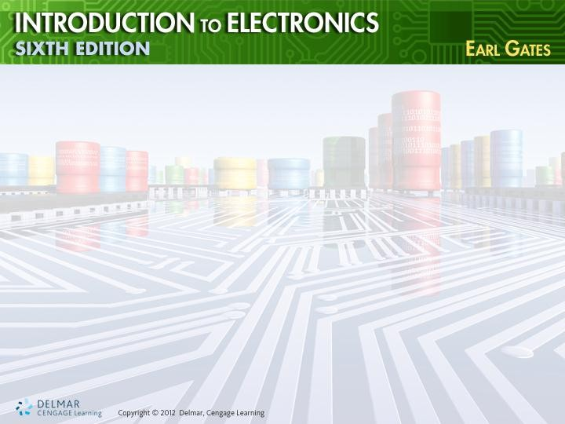
Basic Troubleshooting

Slide 2
Tools for
Troubleshooting
•
Only make a measurement
value is known
Ohmmeter
– Determines an open or short
Voltmeter
when
normal
•
circuit
•
– Measures voltage drop across a component

Slide 3
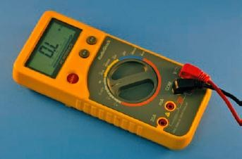
Tools
for
Troubleshooting
(cont’d.)
Figure 40-1. Ohmmeter

Slide 4
Tools
for
Troubleshooting
(cont’d.)
•
Ammeter
– Measures
current flow
• For entire circuit
• Through individual components
Oscilloscope
– Essential for advanced troubleshooting
– Detects presence or absence of a signal
•

Slide 5
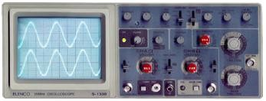
Tools
for
Troubleshooting
(cont’d.)
Figure 40-4. Oscilloscope

Slide 6
Tools
for
Troubleshooting
(cont’d.)
Isolation transformer
– Isolates circuit that does not use a
transformer for its power supply
Soldering iron, solder, and desoldering tools
– For removing and replacing components in printed circuit board
•
•
a

Slide 7
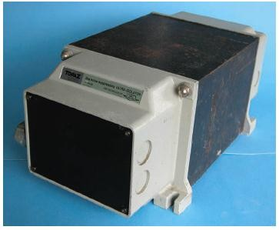
Tools
for
Troubleshooting
(cont’d.)
Figure 40-5. Isolation transformer.

Slide 8
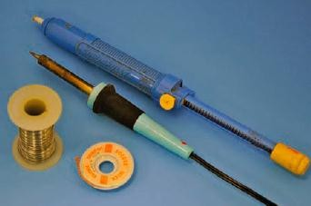
Tools
for
Troubleshooting
(cont’d.)
Figure 40-6. Tools for successful repairing of
a printed circuit board.

Slide 9
Isolation
Effective
Step one
Techniques
for
Troubleshooting
•
– Manually check the printed circuit before
power is applied
Step two
– Apply power to determine if an electrical
problem exists
•

Slide 10
Isolation
Techniques
for
Effective
Troubleshooting
Step three
– Troubleshoot
(cont’d.)
•
• Eyesight, smell, listen, and touch
Step four
– Determine if circuit will work when exposed
its environment
•
to

Slide 11
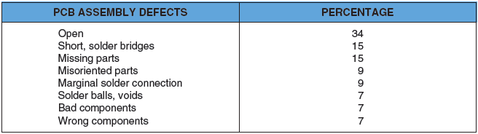
Common
Types
of
Defects
Figure 40-8. Common
defects of printed circuit board assembly.

Slide 12
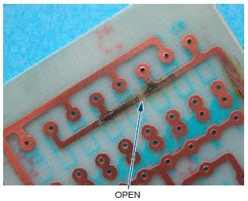
Common
Types
of
Defects
(cont’d.)
Figure 40-9. Open on a printed circuit
board.

Slide 13
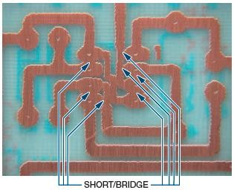
Common
Types
of
Defects
(cont’d.)
Figure 40-10. Shorts on a printed circuit
board.

Slide 14
Troubleshooting
Tips
•
•
•
•
Start with the power of observation
Do not assume a problem is complex
If a problem is difficult, step away to think
Touch a ground point to prevent ESD

Slide 15
Documentation
Schematic diagram
•
–
Most important document when
troubleshooting
–
–
–
Shows
Shows
Shows
how circuit is connected
voltage drops in a circuit waveforms at various test
points
•
Secret of successful troubleshooting
– Good documentation

